Slide 1
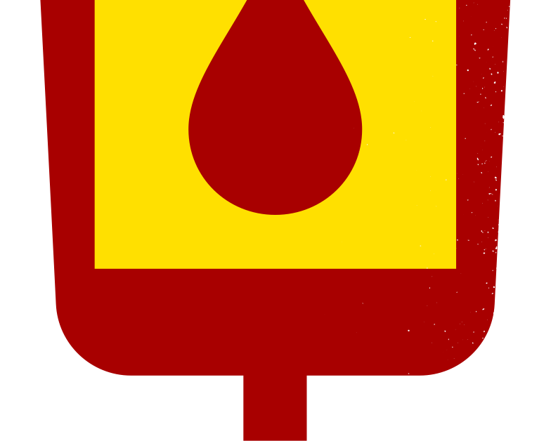

BLOOD
SAMPLES
Graduation Project Presentation
11/2/2024

Slide 2
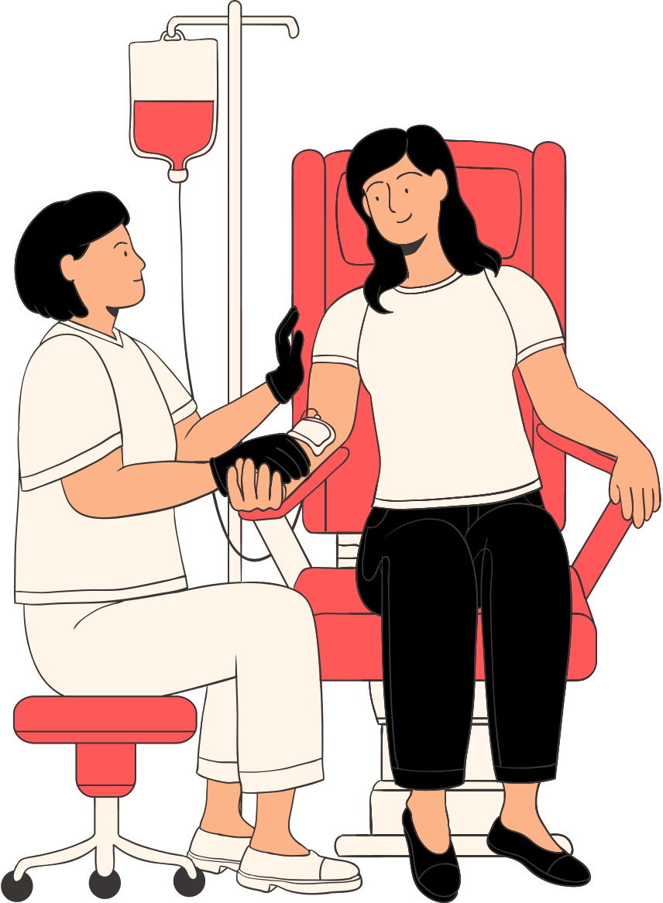
CONTENTS
Introduction
01
04
Relational Work
Problem and Idea
02
05
Analysis
Idea and Solution
03
06
Design

Slide 3
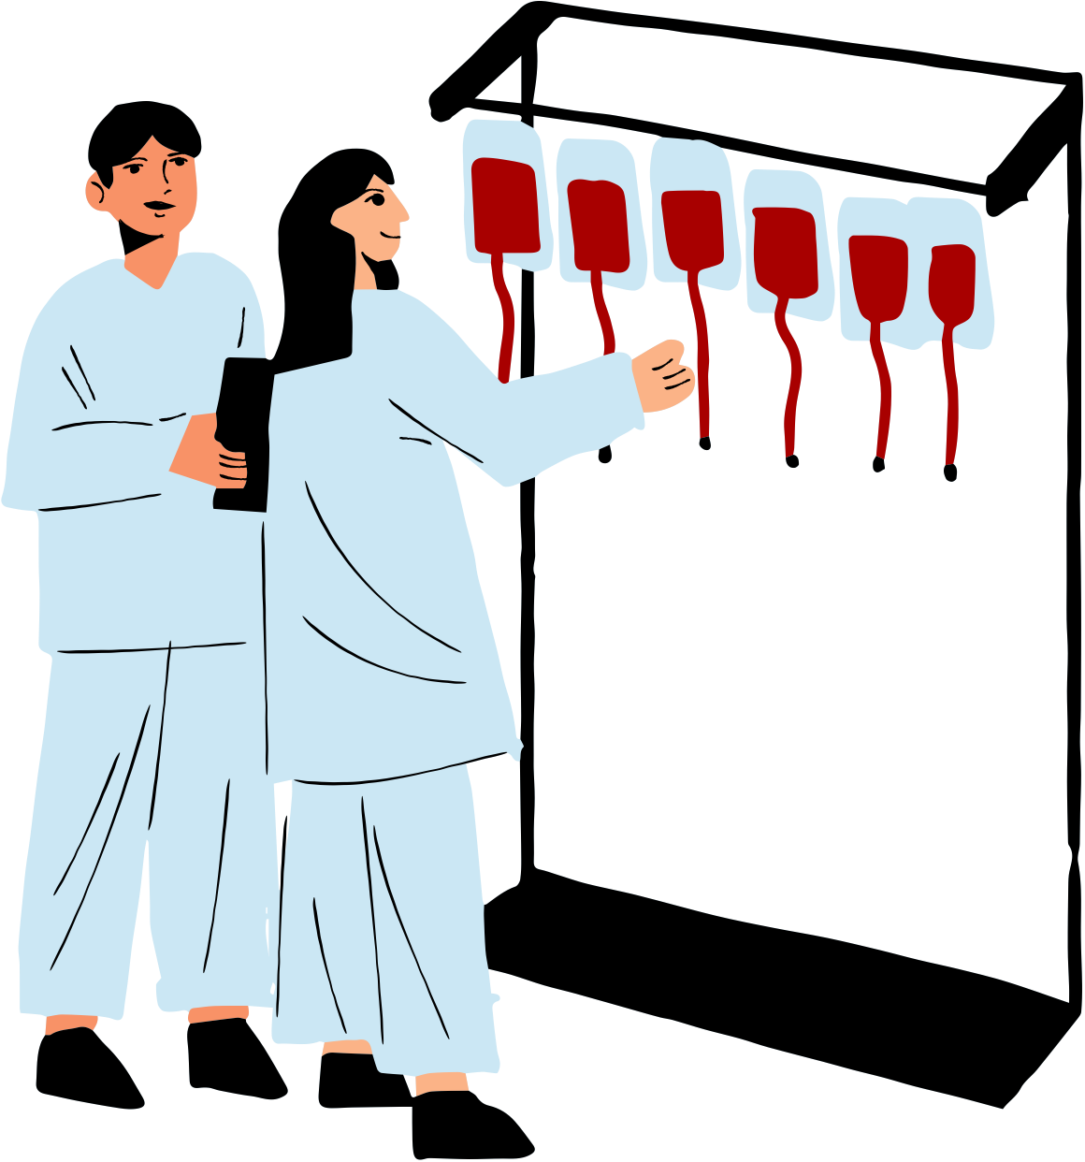
INTRODUCTION
Welcome to our presentation on our Graduation Project – an innovative application poised to revolutionize blood donation and disease prediction. In today's rapidly evolving world, the demand for accessible and efficient healthcare solutions has never been more pressing. Our project endeavors to meet this demand by addressing two crucial facets of healthcare – facilitating blood donation and predicting diseases – leveraging the power of technology.

Slide 4
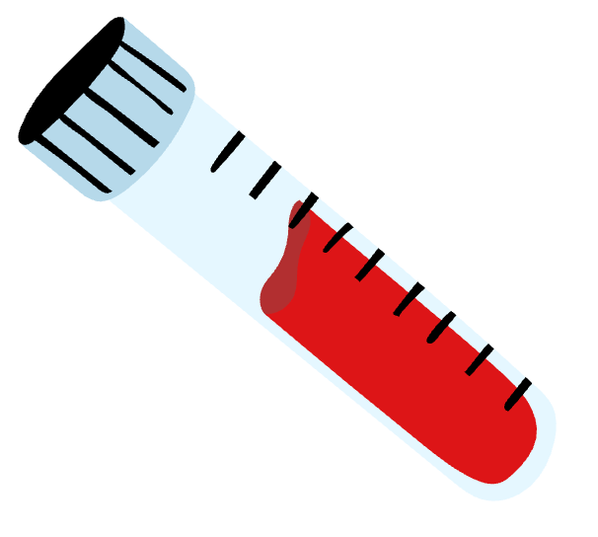
“Blood cannot be manufactured. It can only come from generous donors. The gift of blood is the gift of life itself.”
Dr. Charles Richard

Slide 5
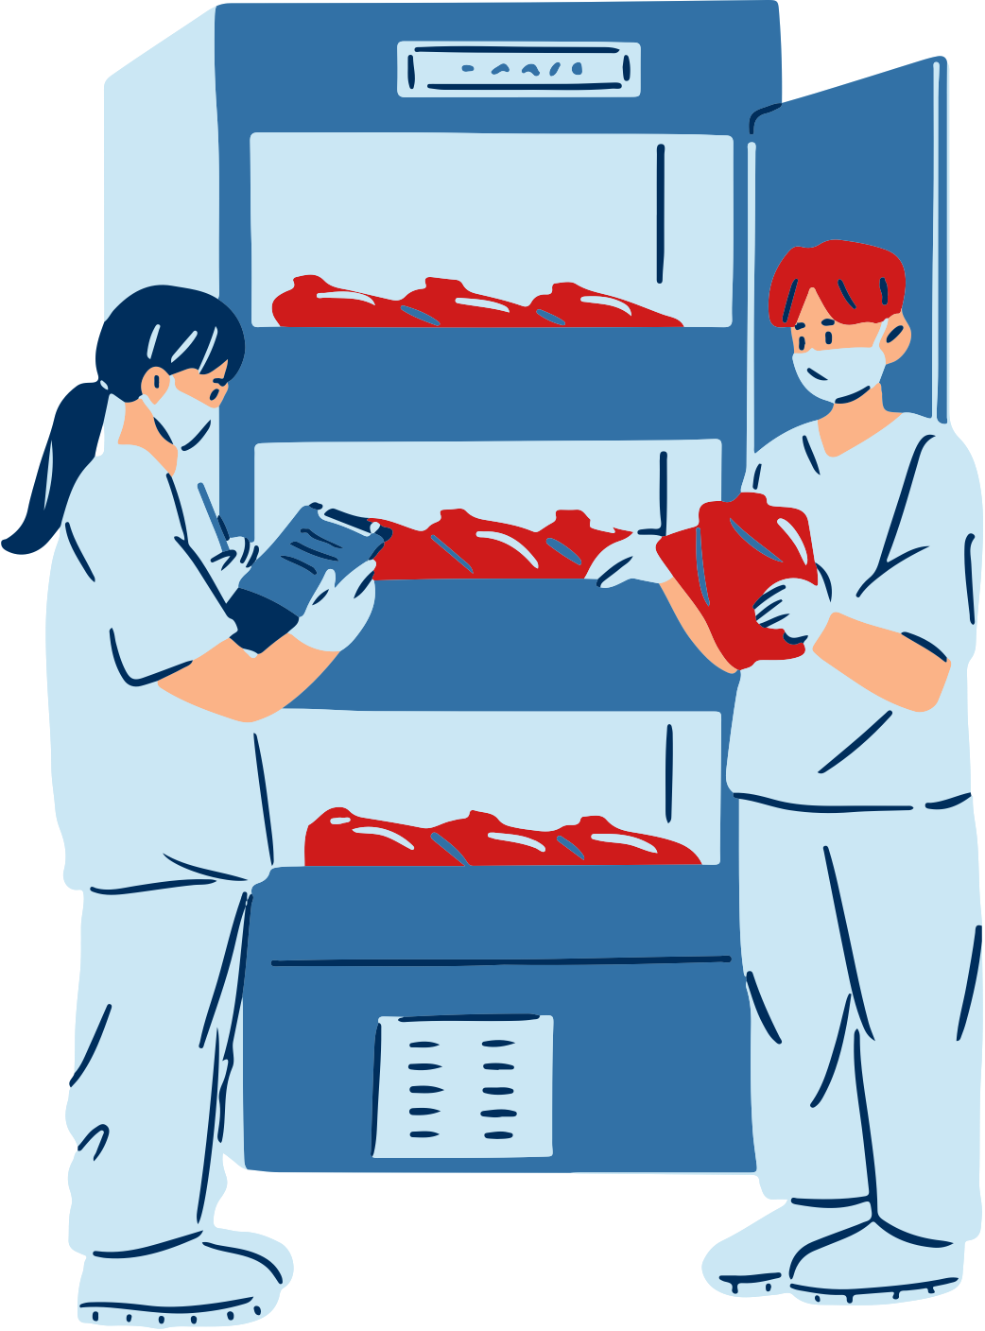
Problem and Idea
In today's world, despite advancements in healthcare, there remains a significant challenge in ensuring an adequate and consistent blood supply to meet the needs of patients worldwide. According to global statistics, every two seconds, someone requires a blood transfusion. However, the availability of donated blood often falls short of demand, leading to critical shortages in healthcare facilities. This discrepancy is particularly pronounced in regions like Egypt.

Slide 6

Problem and Idea
Moreover, beyond the issue of blood supply, there is a pressing need for improved healthcare interventions to predict and prevent diseases. Early detection and intervention are crucial for mitigating the impact of various health conditions, yet access to reliable disease prediction tools remains limited, especially in underserved communities.

Slide 7
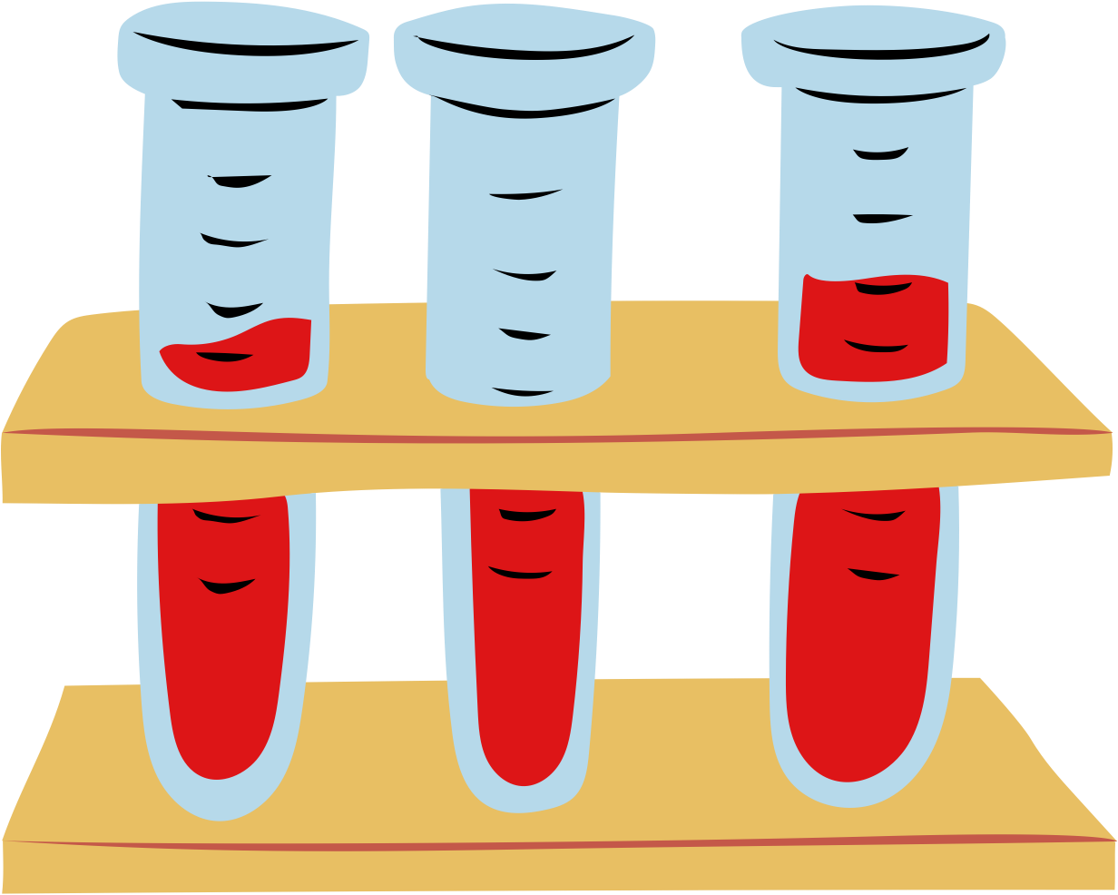
118,400,000
There are 118.4 blood need cases yearly
Despite the ongoing need, less than 1% of Egyptians regularly donate blood.

Slide 8

Idea and Solution
Blood Donation Facilitation:
The project recognizes the inefficiencies and barriers present in traditional blood donation systems. These include limited visibility of donation centers, cumbersome registration processes, and difficulties in matching donors with recipients in urgent situations. Our application seeks to streamline the entire blood donation process by providing a centralized platform that connects willing donors with individuals or organizations in need of blood. Through intuitive user interfaces and features such as real-time location-based searches and scheduling capabilities, the app aims to increase the accessibility and efficiency of blood donation, ultimately saving lives in critical situations.

Slide 9
Idea and Solution
Disease Prediction:
Early detection and prediction of diseases play a crucial role in improving healthcare outcomes and saving lives. However, accurately diagnosing diseases based on symptoms and samples can be challenging, especially in resource-constrained settings. Our application leverages cutting-edge machine learning algorithms to analyze user-provided symptoms and samples, generating predictions regarding the likelihood of specific diseases. By empowering individuals with timely insights into their health status, the app aims to facilitate early intervention and proactive healthcare management, ultimately improving health outcomes and reducing the burden on healthcare systems.

Slide 10
Idea and Solution
1- Blood Donation Facilitation:
      Finding nearby blood donation centers.
      Reminders for donation eligibility.
      Tracking donation history.
2- Disease Prediction Feature:
Data collection for health parameters.
Utilization of machine learning algorithms for prediction.
Early detection of diseases.
Providing personalized health recommendations.

Slide 11
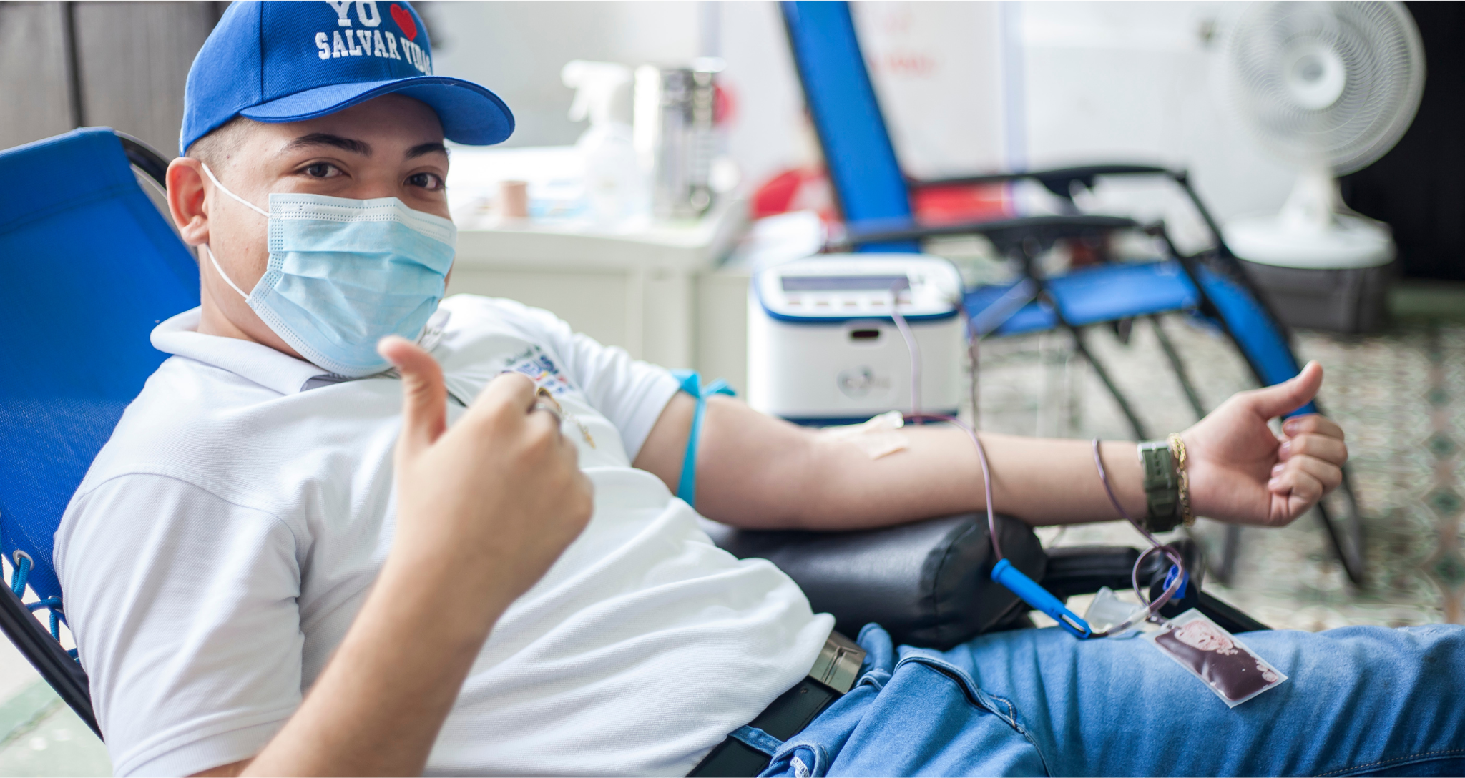
A picture is worth a thousand words.

Slide 12
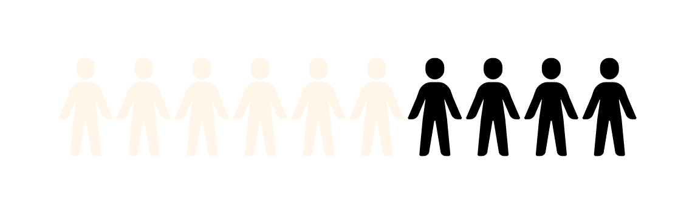
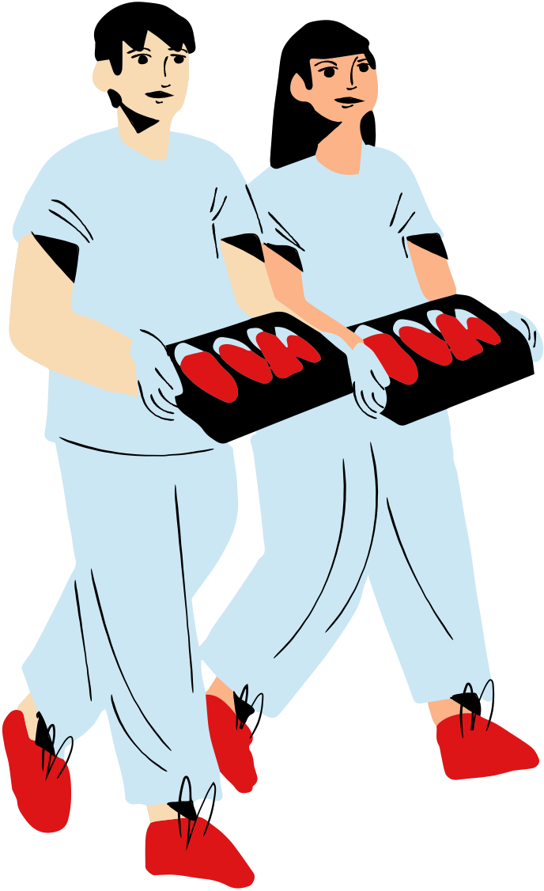
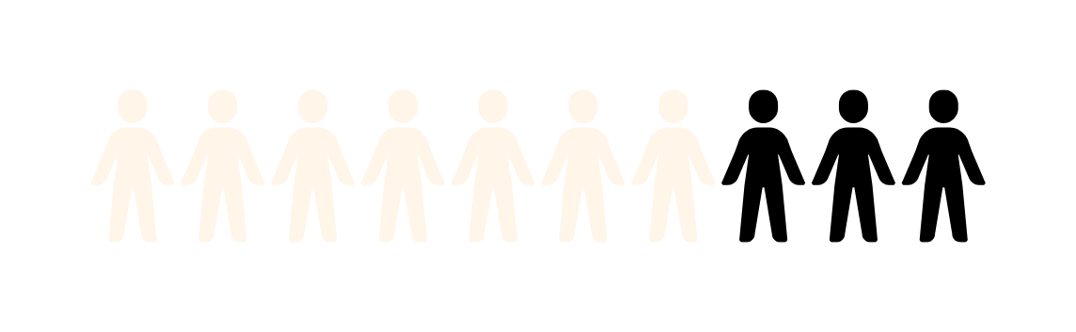
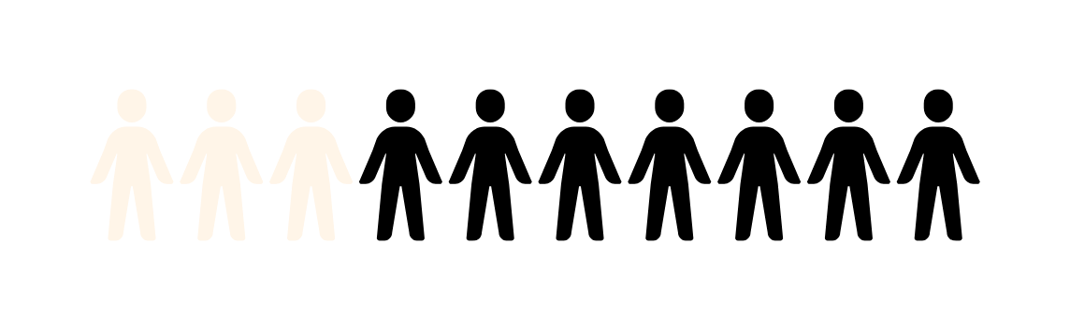
DONATION
Blood Type - 60%
Blood Type B - 70%
Blood Type O - 30%

Slide 13
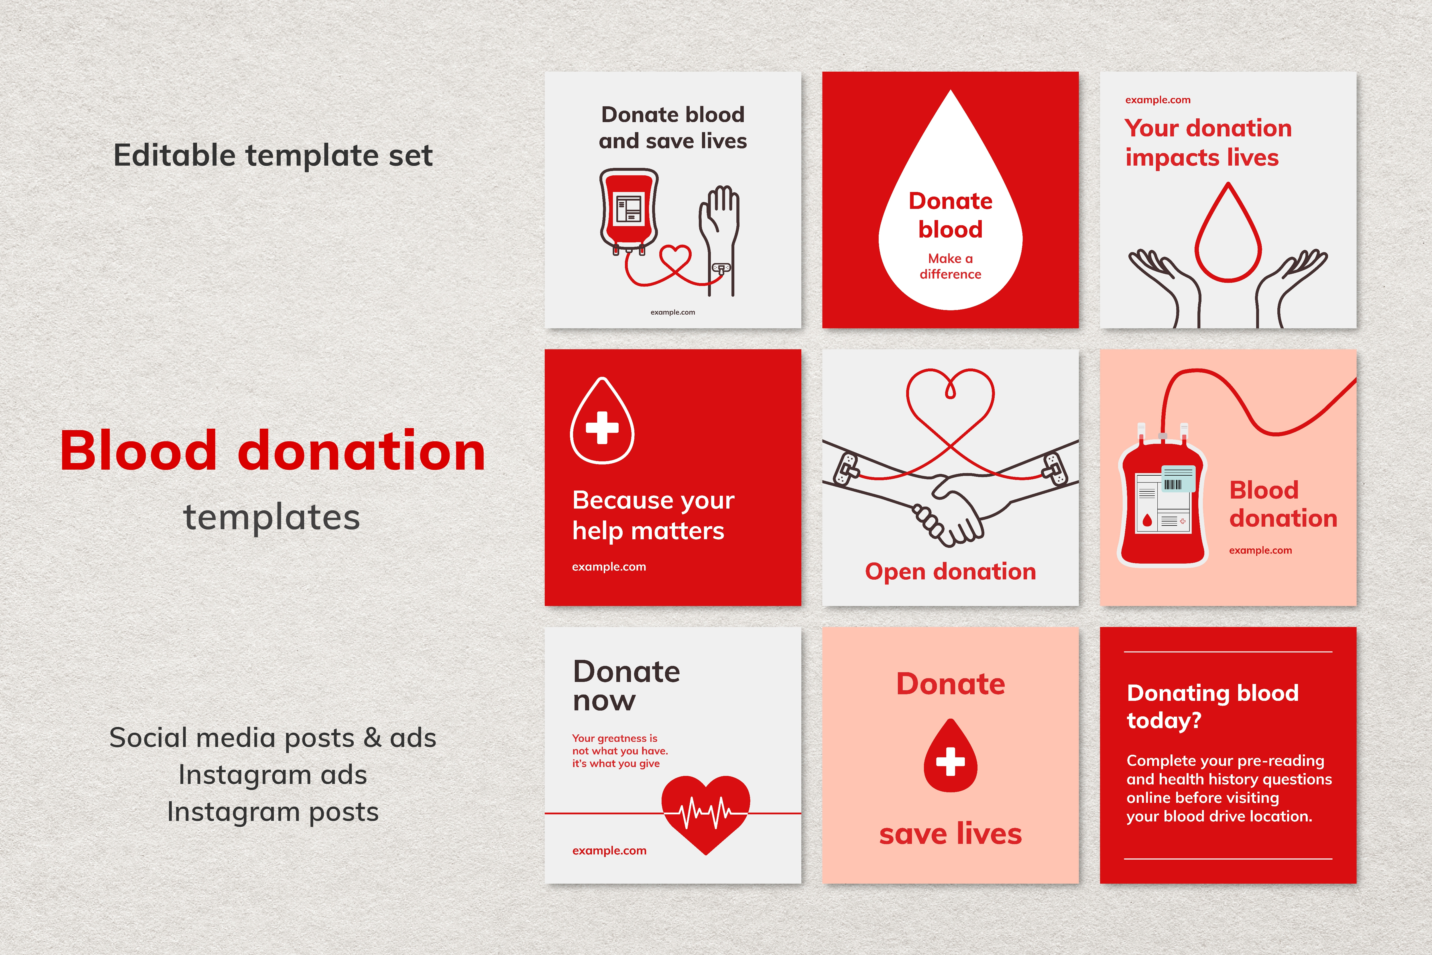
Relational Work

Slide 14
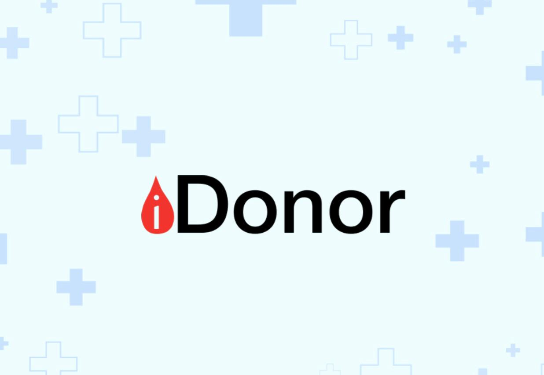
1. Review about iDonor

Slide 15
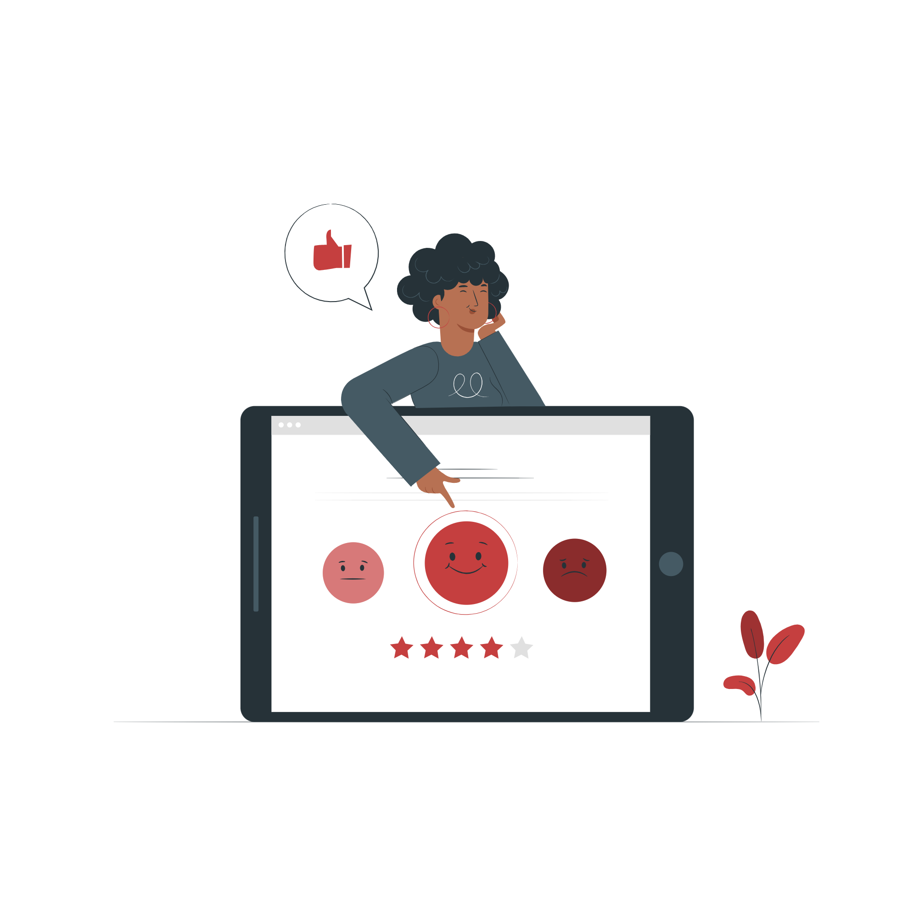
1. Review about iDonor
An application that helps establish a link between the person who needs blood and the person who can donate blood, which saves the trouble of searching for a blood donor.
The program is divided into two parts: the first part is that the user donates and the second part is that the user searches for a donor, so he chooses the blood type he is looking for.
Users who register as blood donors will receive notifications when someone requires blood.

Slide 16
1. Review about iDonor
If the user wants to donate, he registers his data and blood type then will appear the nearest people with the same blood type.
However, if the user is looking for a donor, he specifies his location and his blood type, and a post is created, and this post will reach the people close to him who have the same blood type.
A person with type “B+” receives a warning in the event of a need for blood type “B+”. If the subscriber donates blood, he does not receive any warning regarding the blood request for two months, as the person cannot donate blood again until two months have passed.

Slide 17
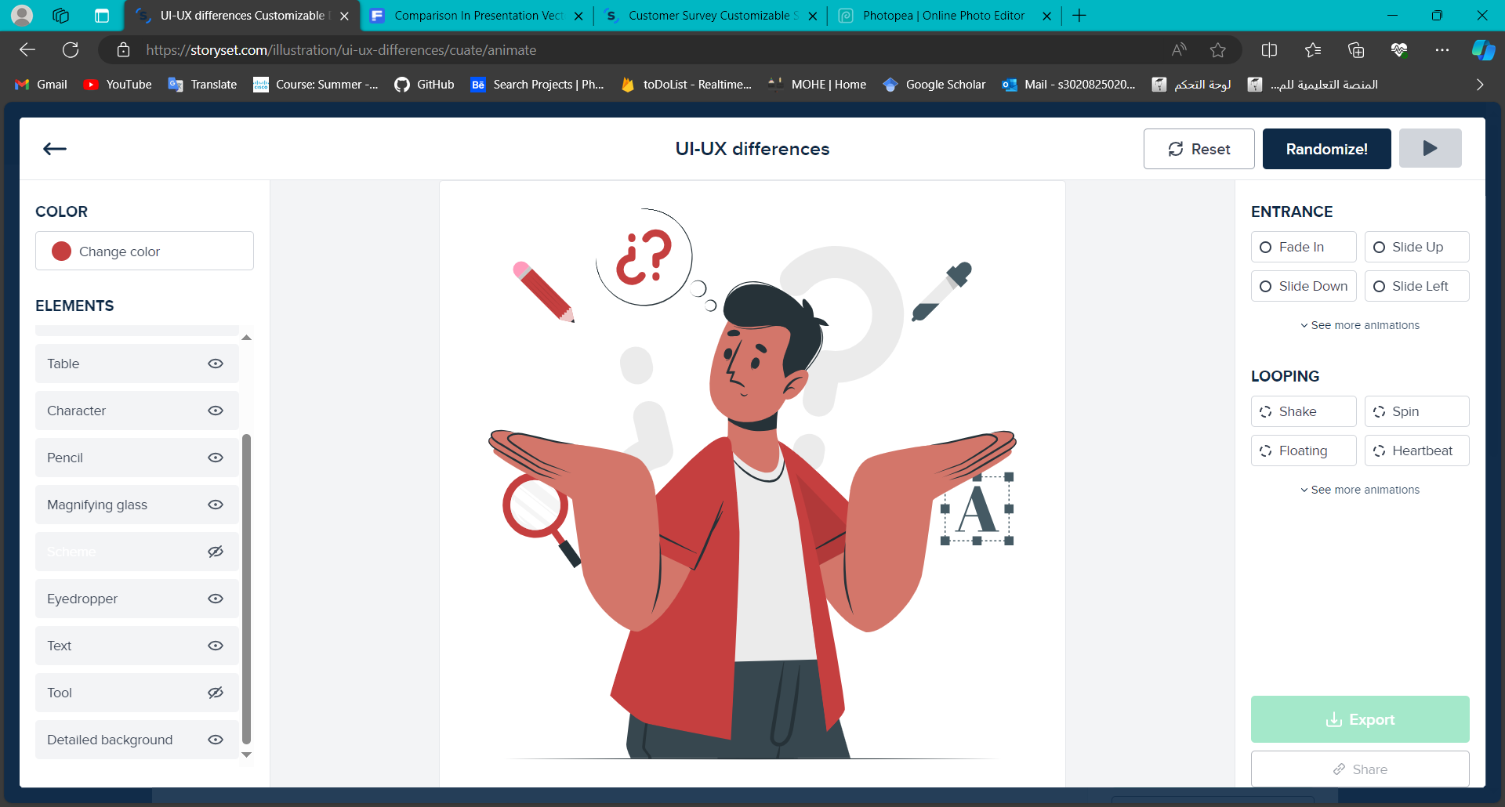
The difference between
iDonor and our project
The user can also test his health and not just donate blood.
It will can determine the location of the user.
It will can Match the user's location with the available location near him.
Raising awareness of the benefits of blood donation.

Slide 18
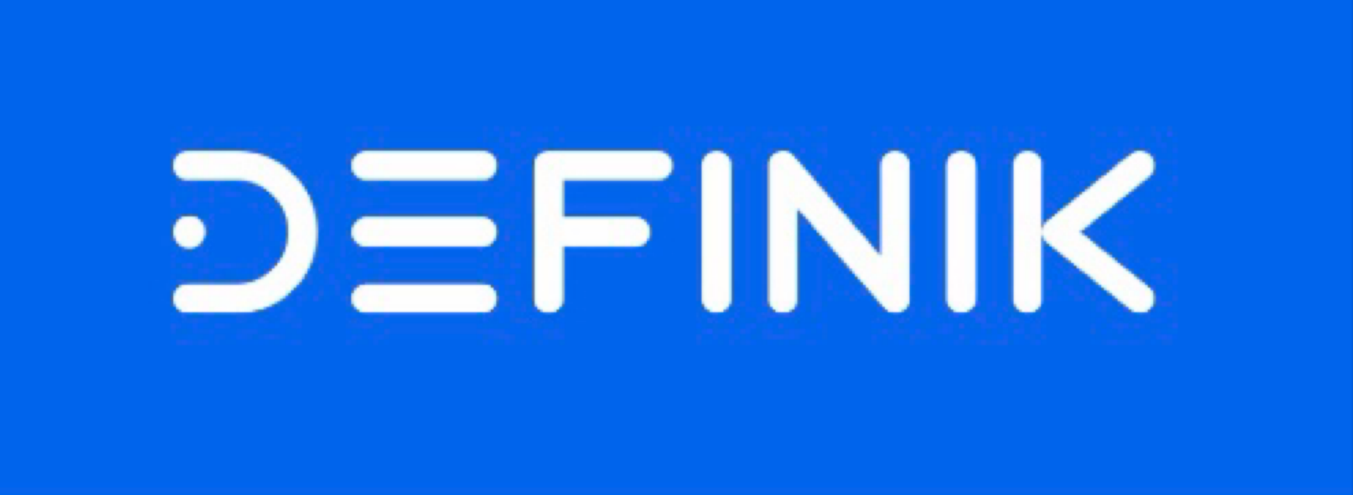
1. Review about Definik

Slide 19
2. Review about Definik
Definik is a fast and cheap solution for early risk detection of common diseases by analyzing laboratory blood tests and creating personalized plan for further monitoring with regular recommendations based on AI.
Definik includes regular monitoring, which helps to track changes in the user's health status and provides timely recommendations.
With Definik users can receive early risk detection of a range of conditions allowing them to take action before symptoms worsen.

Slide 20
2. Review about Definik
This personalized approach ensures that users receive the support they need to manage their health proactively.
Everyone can use Definik because of its simple interface.
With Definik, users can take control of their health and live life to the fullest.

Slide 21
The difference between Definik and our application
– Definik application:
The diagnosis of diseases depends on laboratory blood tests.
– our application (blood samples):
• This application performs the same function, but the difference here is that this application works on the iOS system only, and when giving some data to it, it gives wrong results and almost does not give results at all. The difference also is that this application works on the feature of predicting diseases only, but our application works on the feature Prediction and blood donation.

Slide 22
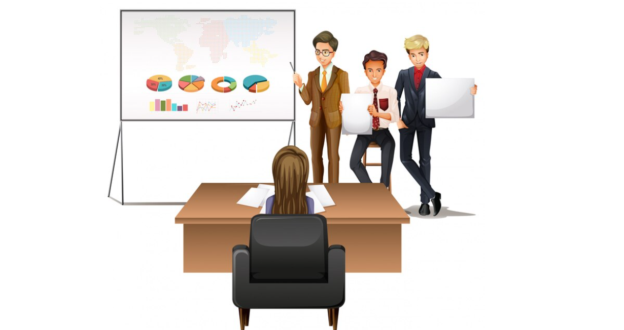
Analysis

Slide 23
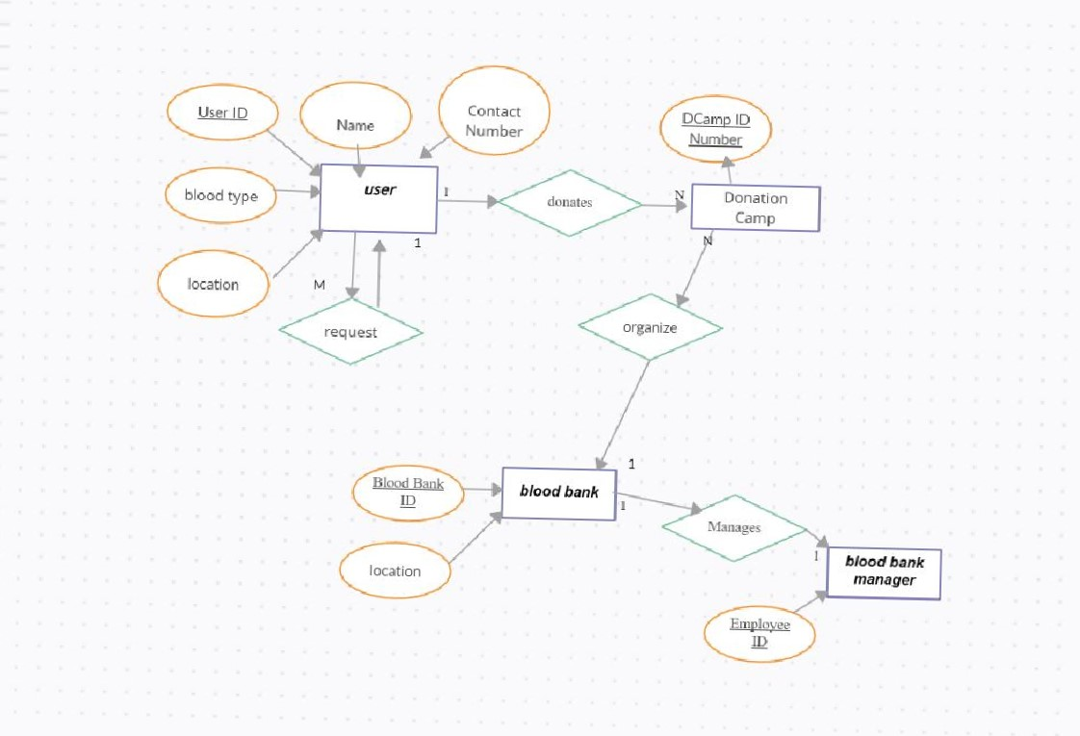
ERD

Slide 24
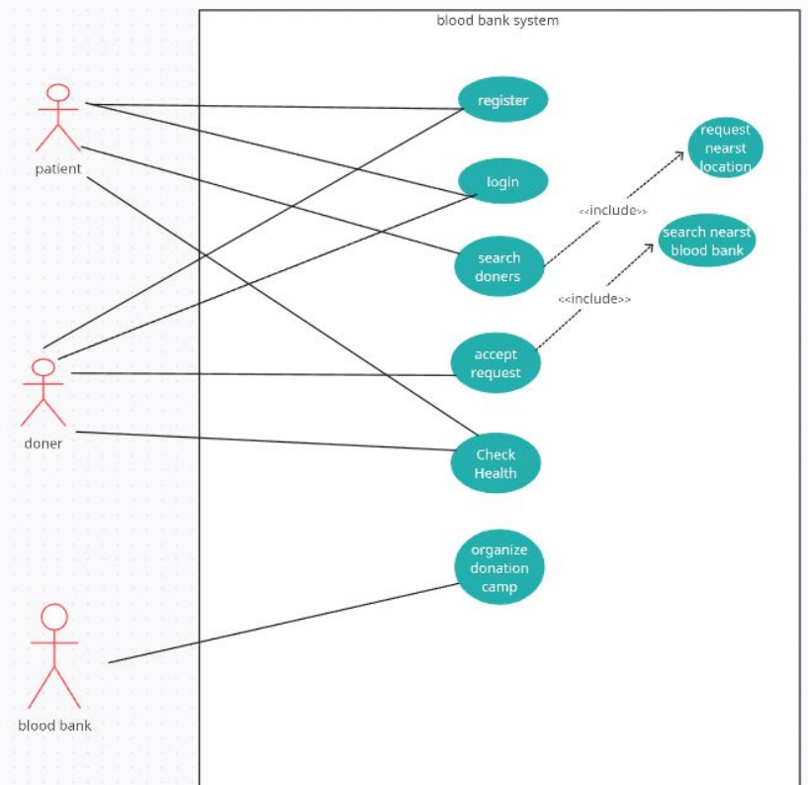
Use Case Diagram

Slide 25
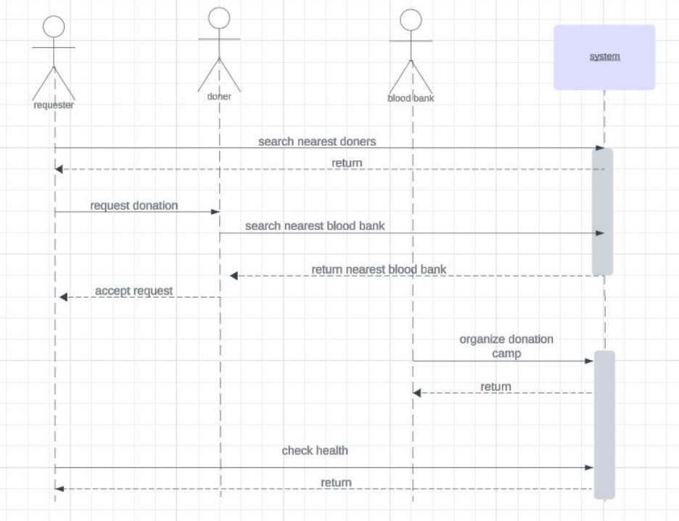
System Sequence Diagram

Slide 26
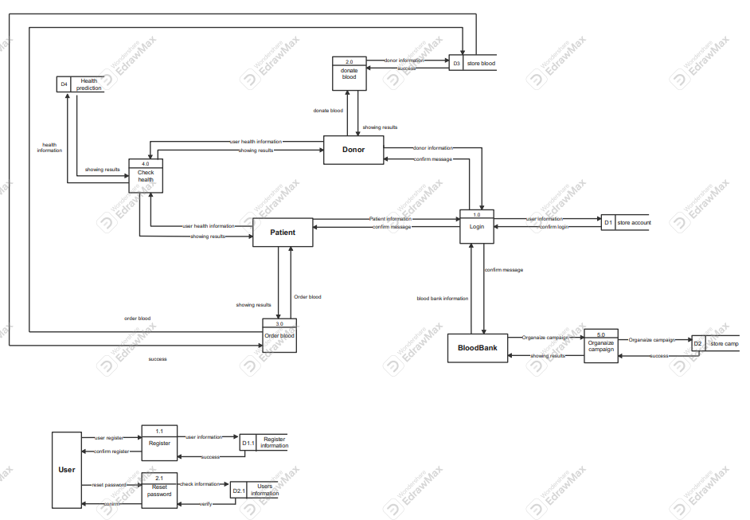
Data Flow Diagram

Slide 27
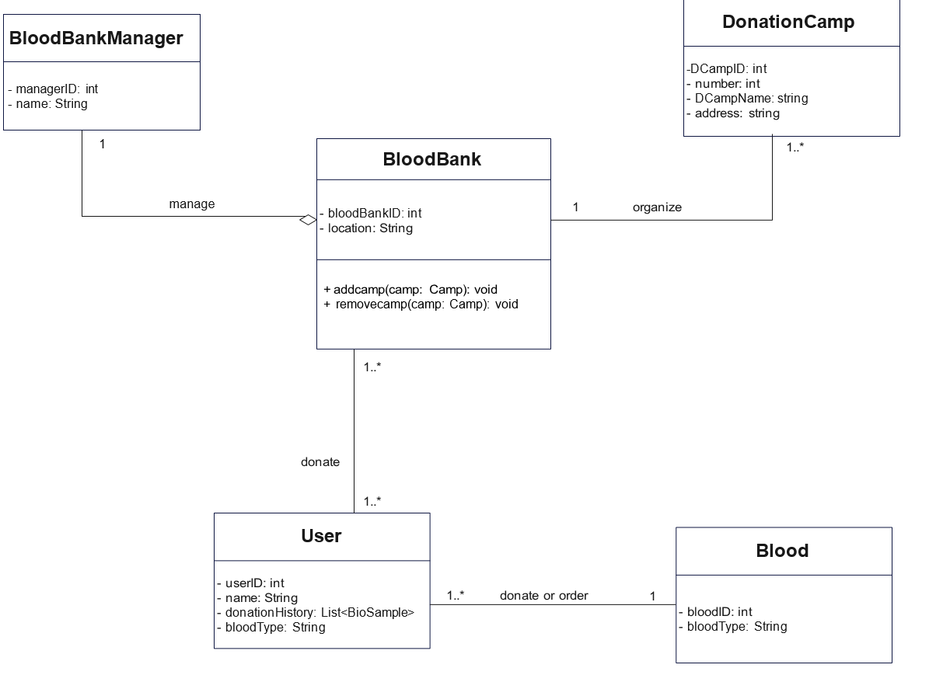
Class Diagram

Slide 28
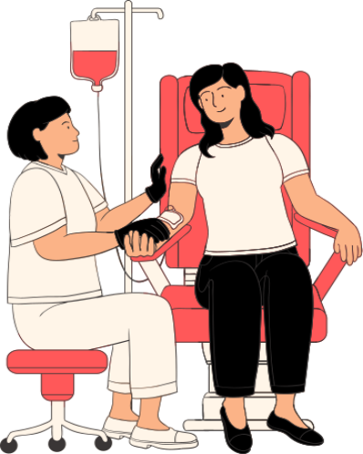
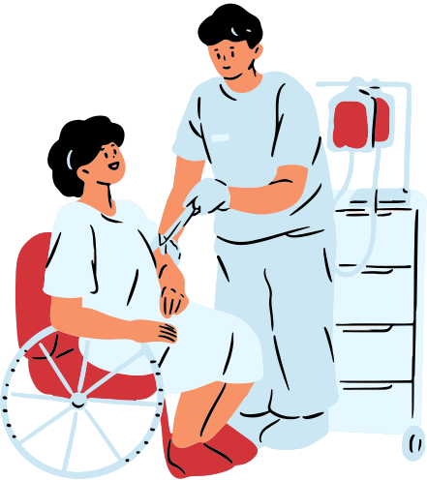
Design
Now, we will show the design for our mobile application (blood samples) by sequence of our pages.

Slide 29
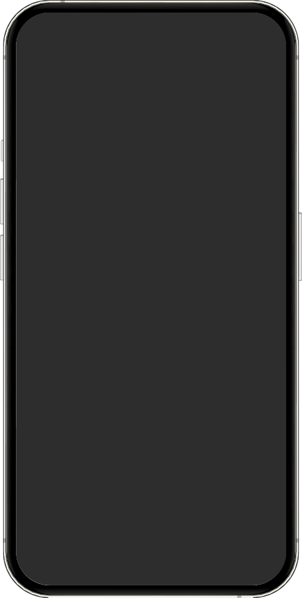
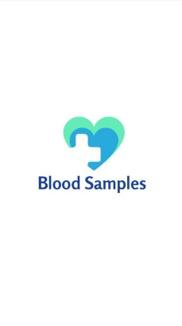

Splash screen
This is splash screen for the application as it is automatically takes few seconds and navigate us to welcome screen

Slide 30
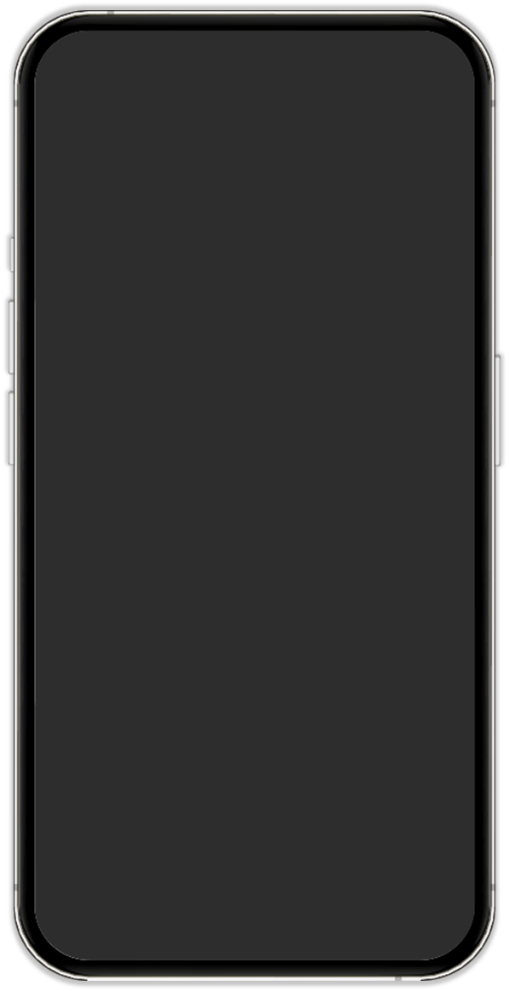
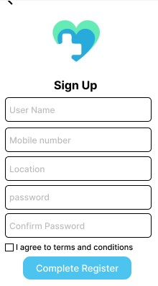
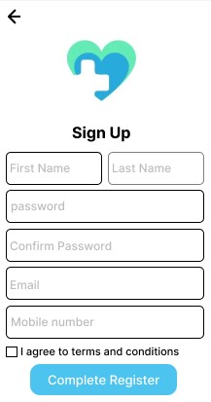
Sign up screen for user & Blood bank
-the user can sign up for the application by using the Name ,Password ,Email and Phone number so the Account for the user created and enter to the application and navigate in it.
-the blood bank can sign up for the application by using User Name ,Phone number ,Location and password.so the Account created and enter to the application.

Slide 31
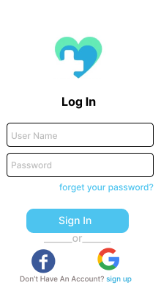
Log in screen for user & Blood bank
- the user and the blood bank can log in for the application when he already have an account which he only writes the email and password.

Slide 32
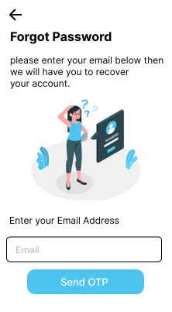
Forget password screen
If the user forget his password he can enter his email and we can send him OTP verification code to create a new password and enter to the application again and use it.

Slide 33
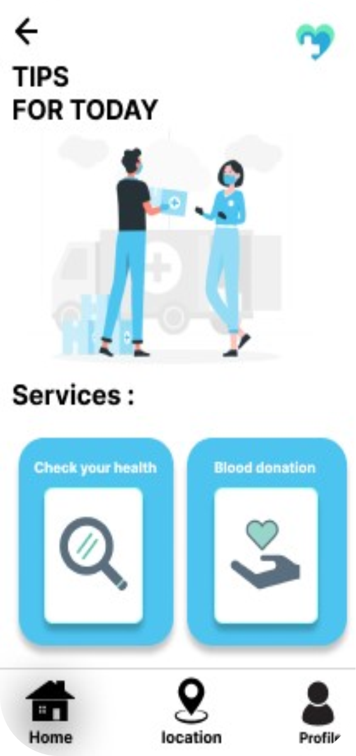
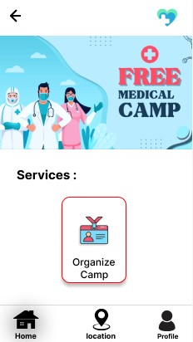
Home screen for User & Blood bank
-this is the home screen for user which contains services for the user as the user can check his health and make donation process.
-the other one is the home screen for blood bank Which contains services as Organize camp for donors

Slide 34
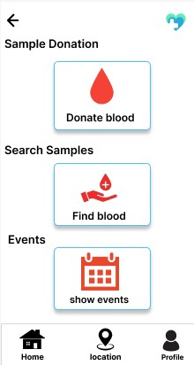
Blood donation services screen
this is the Donation services which the user can donate for others and also can find blood by searching for donors and user can show events that he can donate in them .

Slide 35
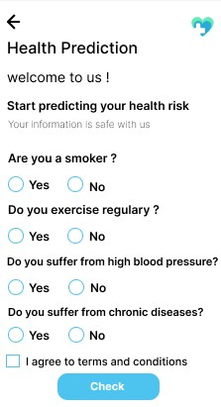
Health prediction screen
check your health services as, the user can check for his health and makes prediction and regular checks so it makes easily treatment if he found the disease early

Slide 36
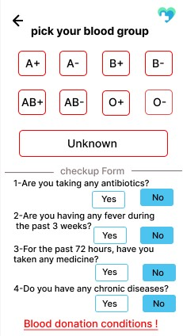
Donating blood screen
this is for the user who wants to donate so he can picks his blood type and see the blood donation condition ,so he can donate if the donation conditions matches with his condition

Slide 37
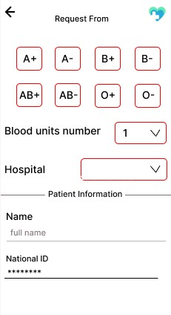
Find blood screen
this is for the user who wants blood ,so he enter the hospital who was in and write his name and ID so he sends request to the people in the hospital location to donate to him

Slide 38
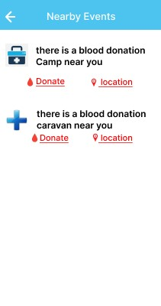
Nearby Events screen
this the Caravans and the events in the area of the donor that can donate in them

Slide 39
Find blood screen
this is the home screen which contains services for the blood bank as the blood bank can Organize Camp for the donors to donate in it

Slide 40
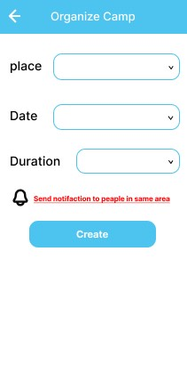
Organize Camp screen
this is screen for organizing camp which the blood bank choose the place and the date with the duration and matches the location with donors to send notification to them about the camp details

Slide 41
UI Design
Now, we will show the design for our website (blood samples) by sequence of our pages.

Slide 42
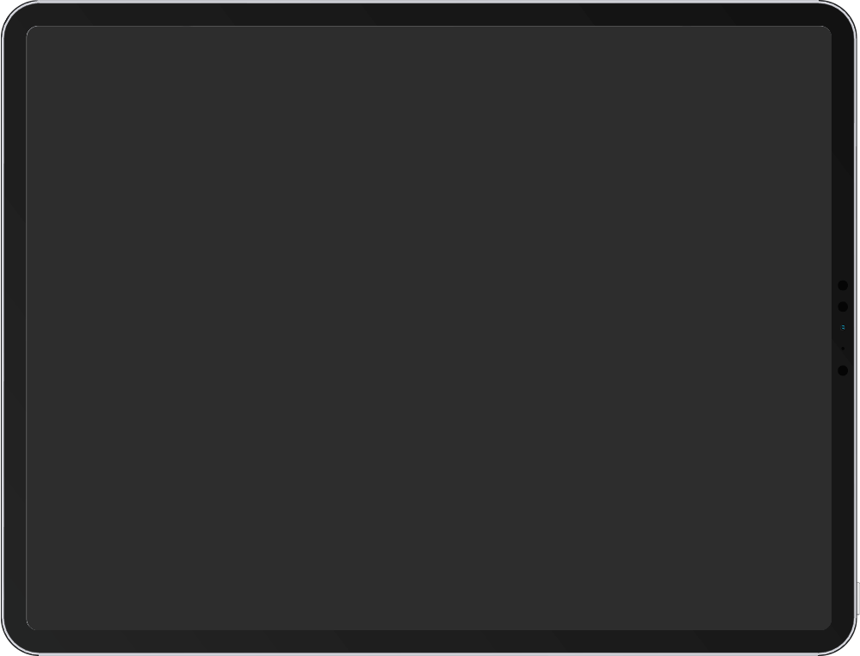
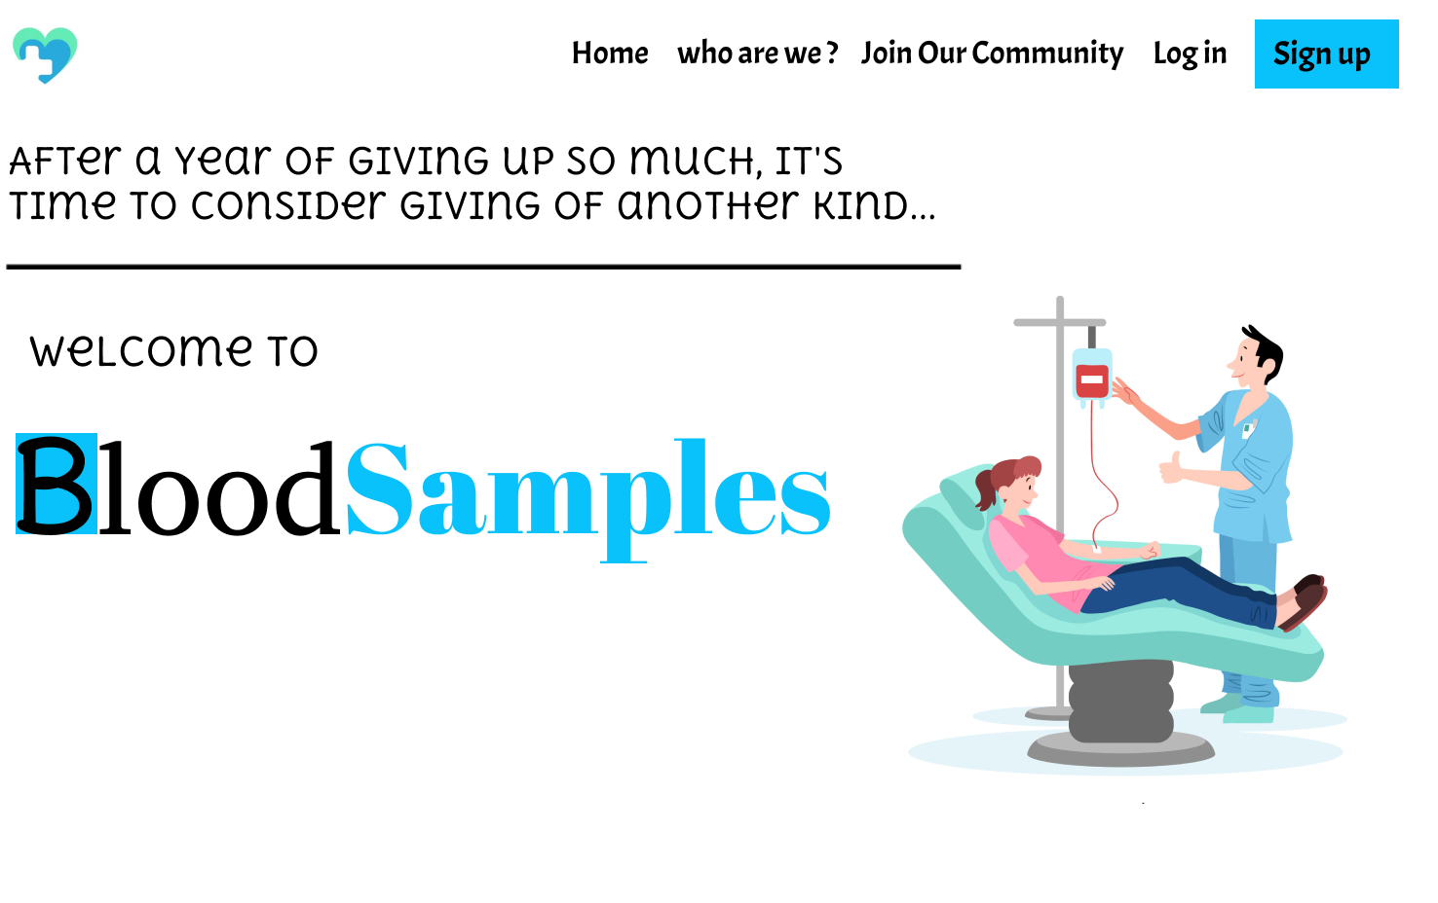
Welcome screen
The first page that appears when you open the site.

Slide 43
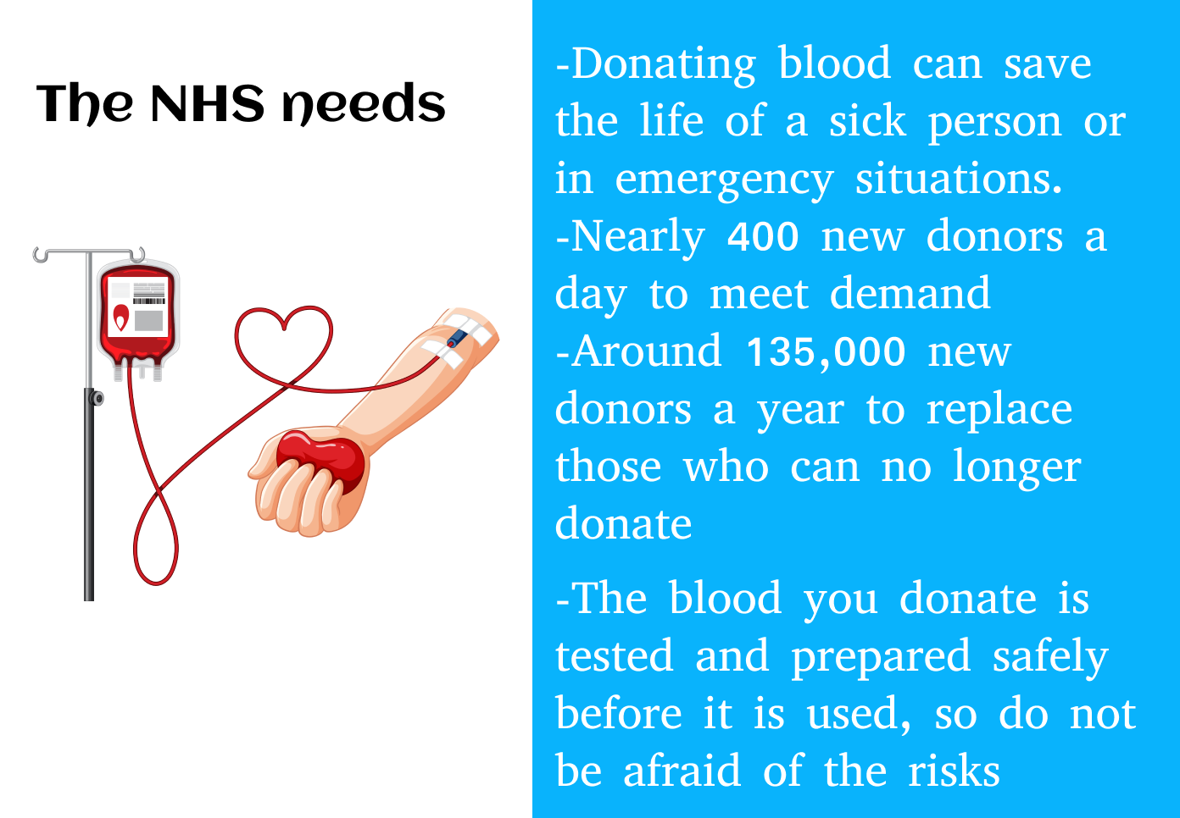
Awareness screen
this is awareness screen to show the benefits of donating blood.

Slide 44
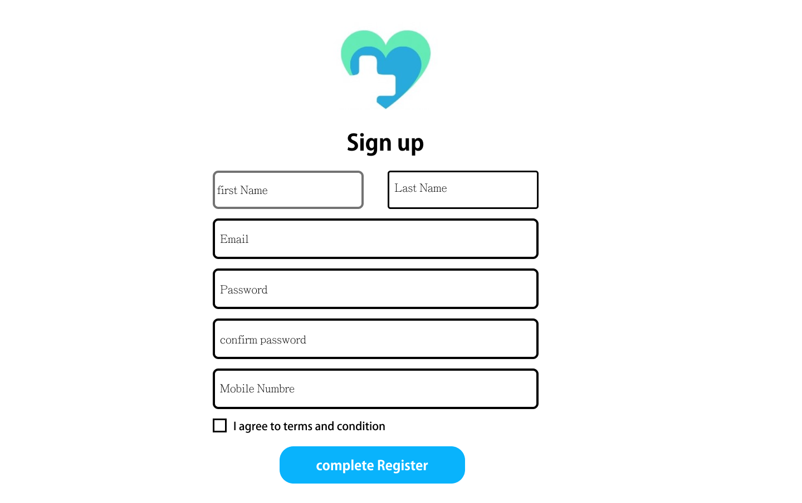
Sign up screen
the user can sign up for the website by using the Name ,Password ,Email and Phone number so the Account for the user created and enter to the website and navigate in it.

Slide 45
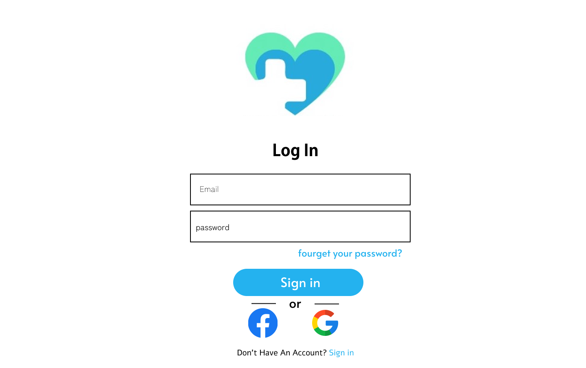
Log in screen
the user can log in for the site when he already have an account which he only writes the email and password.

Slide 46
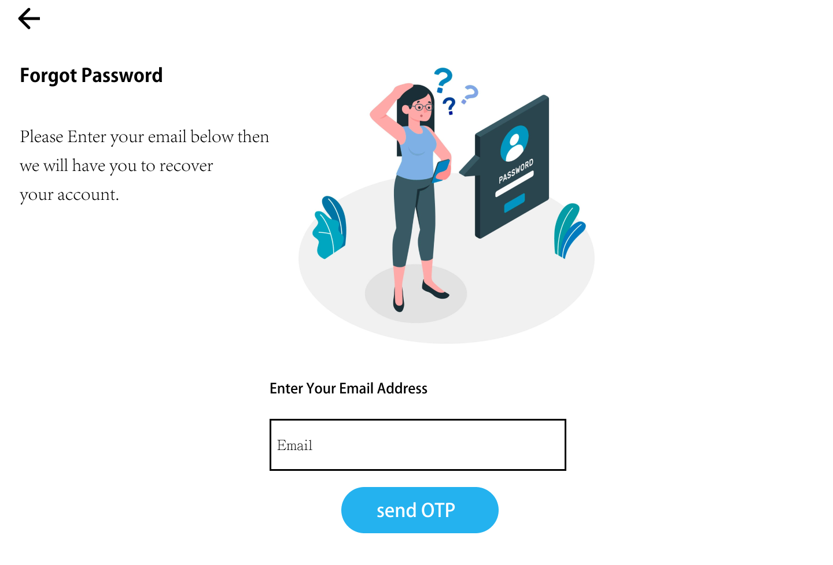
Forgot password screen
If the user forget his password he can enter his email and we can send him OTP verification code to create a new password and enter to the site again and use it.

Slide 47
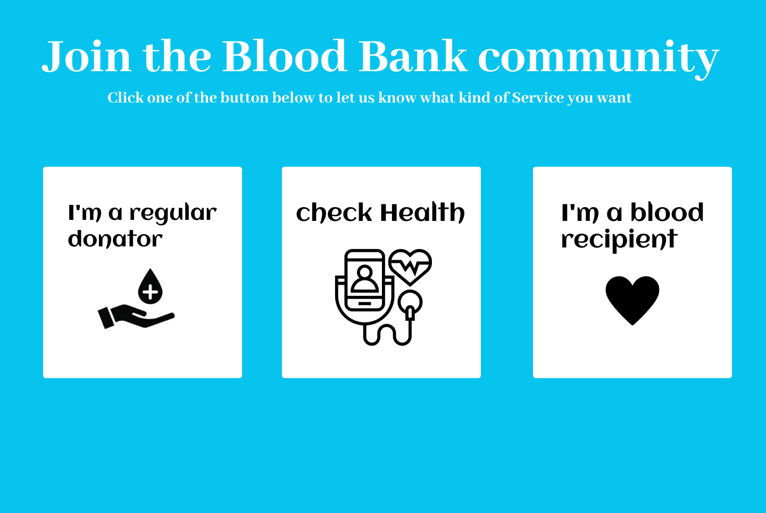
Home screen
which contains services for the user as the user can check his health and make donation process.

Slide 48
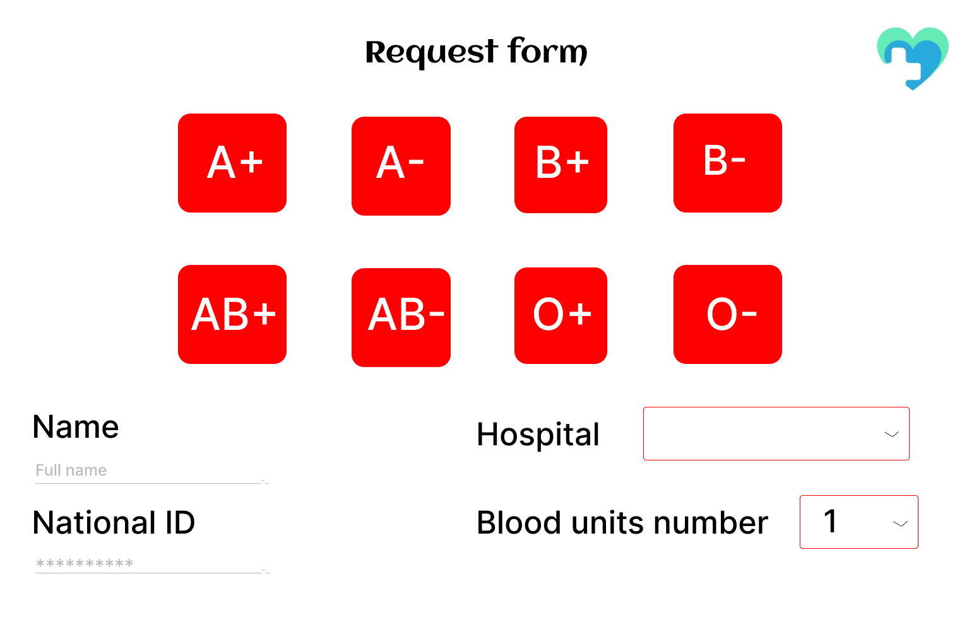
Find blood screen
this is for the user who wants blood ,so he enter the hospital who was in and write his name and ID so he sends request to the people in the hospital location to donate to him.

Slide 49
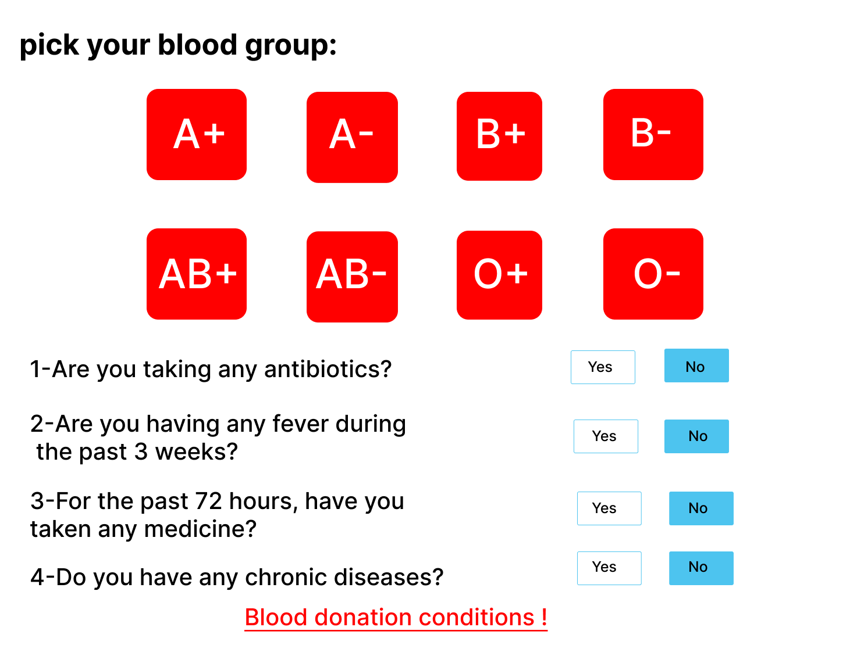
Donating blood screen
this is for the user who wants to donate so he can picks his blood type and see the blood donation condition ,so he can donate if the donation conditions matches with his condition.

Slide 50
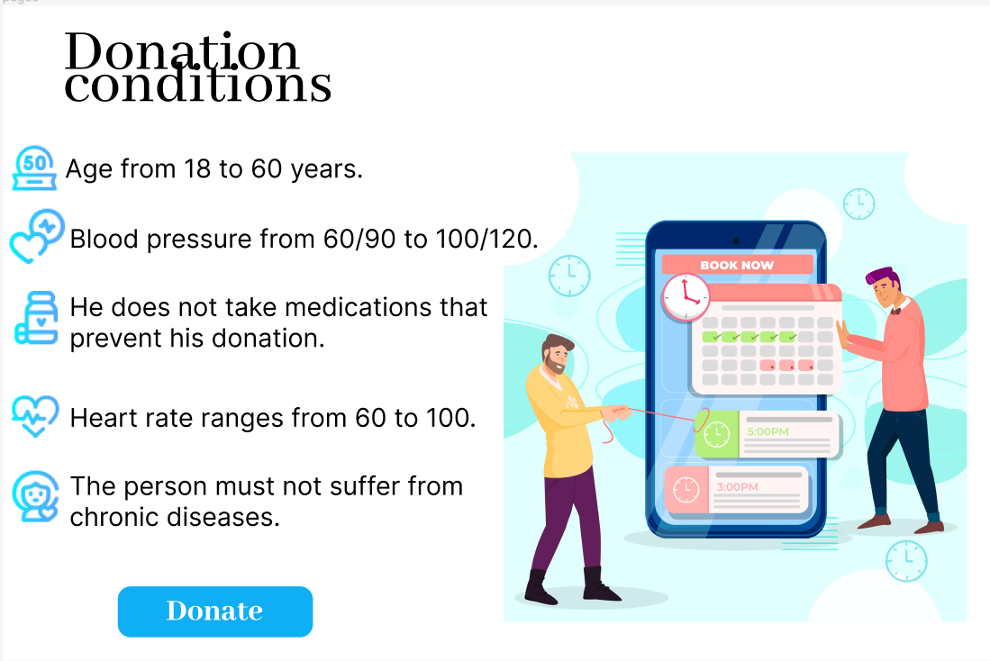
Donation conditions screen
the user who wants to donate, must know the donation conditions.
If the conditions are met, he can donate safely and there is no risk to him.

Slide 51
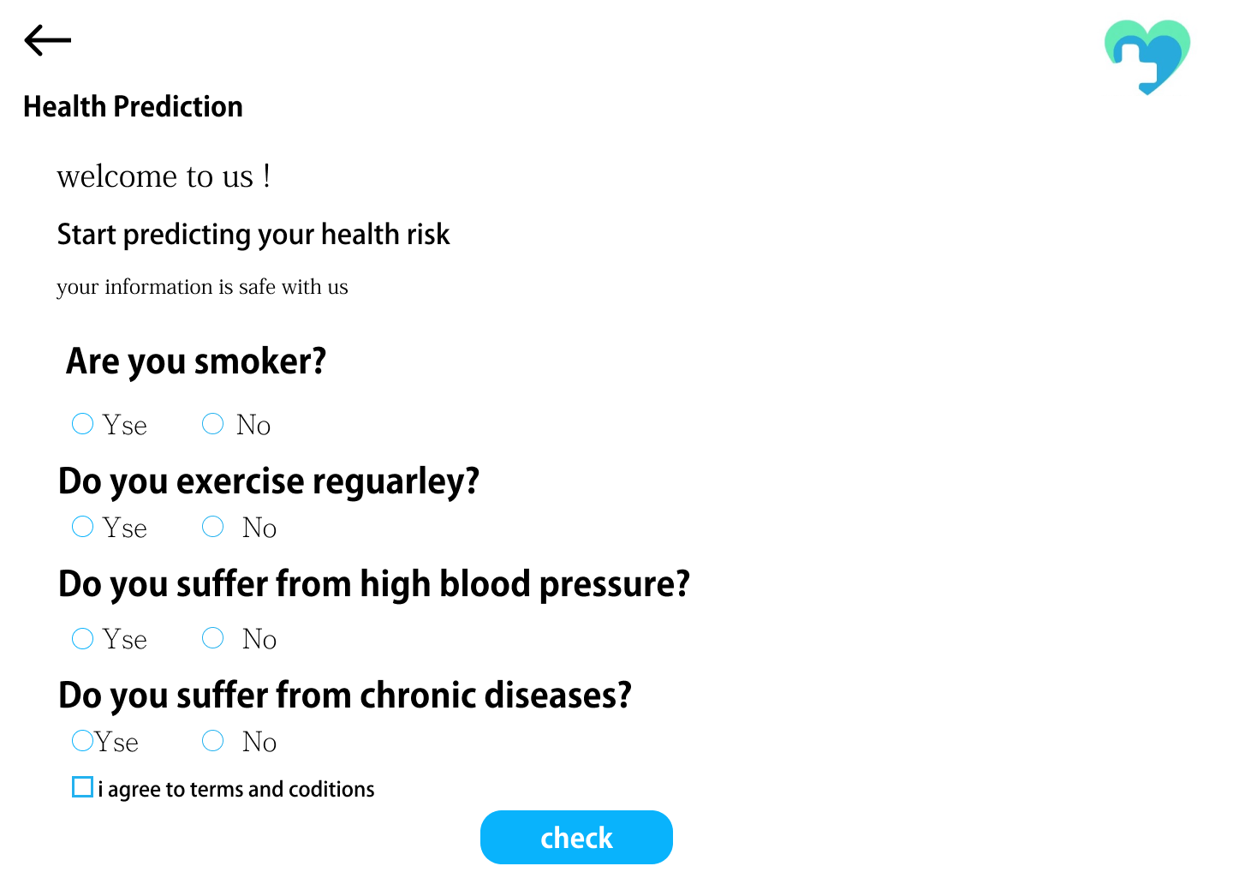
Health prediction screen
check your health services as, the user can check for his health and makes prediction and regular checks so it makes easily treatment if he found the disease early.

Slide 52

Organize camp screen
this is screen for organizing camp which the blood bank choose the place and the date with the duration and matches the location with donors to send notification to them about the camp details.

Slide 53

Tools and Team Members

Slide 54


Tools and Back-Ground
HTML
CSS
Figma
NodeJS
ExpressJs
MongoDB
Main Office
AI
Supervised Machine Learning
Python
Jupyter NoteBook
Sickit-Learn
Contact
Flutter
Dart
Figma
GetX
Cupertino
Branch Office
Visit Us

Slide 55
Team Members
Team Leader: Ehab Aboelnaga
Front-end Team:
Ahmed Abdelmeneam
Salah Elden Mahmoud
Machine Learning Team:
Ehab Aboelnaga
Ahmed Awad Saber
Back-end Team:
Ahmed Elwekel
Mohammed Nasser
Mobile Development Team:
Hager Aly Shawky
Salma Said Mahmoud

Slide 56

THANK
YOU!

